Slide 1
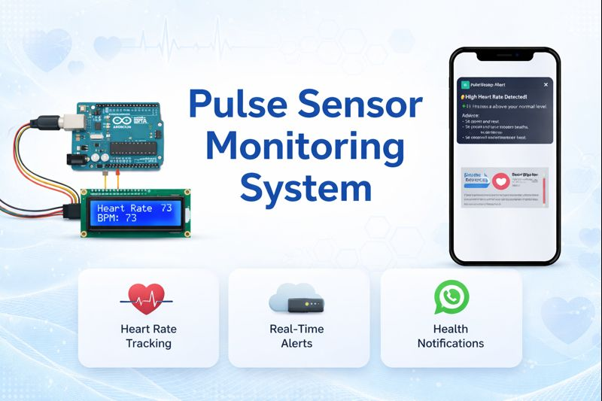

Smart Heart Monitoring and WhatsApp Alert System Using Arduino
Real-time Heart Health Monitoring with Emergency WhatsApp Alerts
An Arduino-based system designed to continuously monitor vital heart parameters and automatically notify caregivers when dangerous conditions arise.
By
Daniella Esther
12224313

Slide 2
The Critical Need for Continuous Heart Monitoring
Rising Health Crisis
Heart disease remains the leading cause of death worldwide, with over 17 million deaths annually. Many of these deaths could be prevented with early detection and rapid intervention.
Traditional monitoring methods require hospital visits or expensive wearable devices that don't provide immediate emergency alerts to caregivers or family members.
Delayed Medical Response
Limited Accessibility
Caregiver Anxiety
Without continuous monitoring, critical cardiac events may go unnoticed until it's too late to intervene effectively.
Many patients, especially elderly individuals living alone, lack access to real-time monitoring systems due to high costs.
Families caring for heart patients experience constant worry about their loved one's condition when they're not physically present.

Slide 3
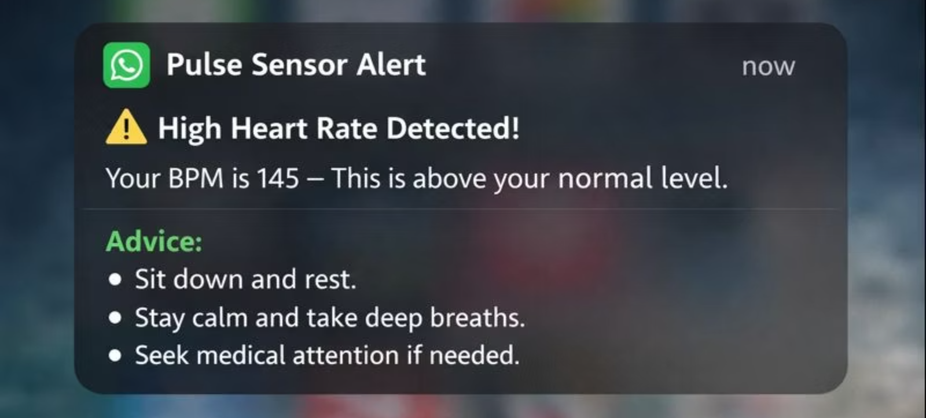




Innovative Solution
A wearable, Arduino-based device that continuously monitors pulse rate and beats per minute (BPM), automatically sending WhatsApp alerts when values cross predefined safe thresholds.
Real-Time Monitoring
WhatsApp Alerts
Continuous pulse and BPM measurement with millisecond precision, capturing every heartbeat and detecting irregular patterns instantly.
Automatic emergency notifications sent via WhatsApp to predefined contacts, including current BPM values and warning status.
Wearable Design
Threshold Detection
Compact, portable form factor that can be worn comfortably throughout the day, enabling 24/7 monitoring without restricting mobility.
Programmable safe zones that trigger alerts when heart rate exceeds normal ranges, customizable for individual patient requirements.

Slide 4




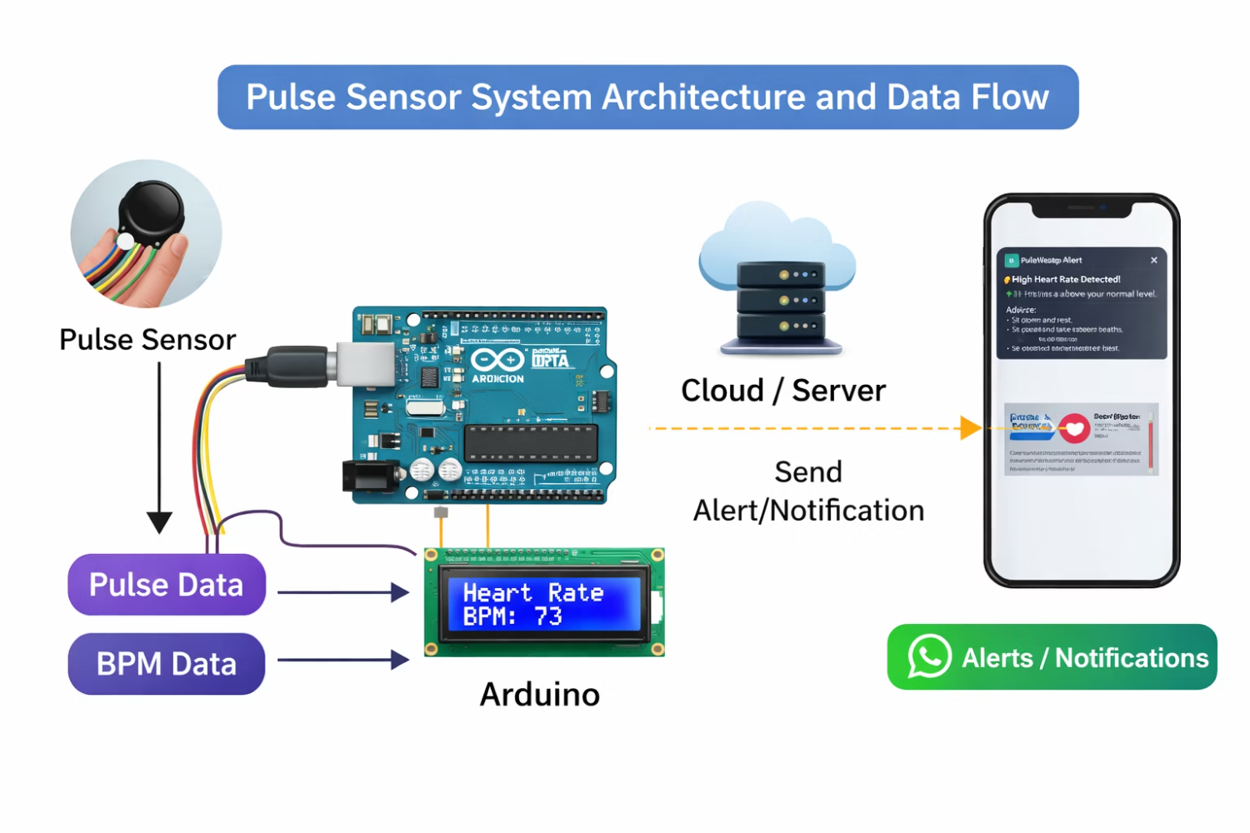
System Architecture Overview
The system operates through a coordinated workflow from data acquisition to emergency notification,
ensuring rapid response to cardiac abnormalities.
Data Acquisition
Arduino Processing
Pulse sensor continuously captures heart rate signals from the patient
Microcontroller calculates BPM and analyzes threshold conditions
Communication
Alert Delivery
WiFi or GSM module establishes internet connection for messaging
WhatsApp message sent to caregivers with critical health data
Key Features
Real-time pulse detection using optical sensing technology
Automatic BPM calculation with high accuracy
Configurable threshold values for different patient profiles
Reliable wireless communication through established protocols
Low power consumption for extended battery life
Scalable design supporting multiple patient monitoring

Slide 5
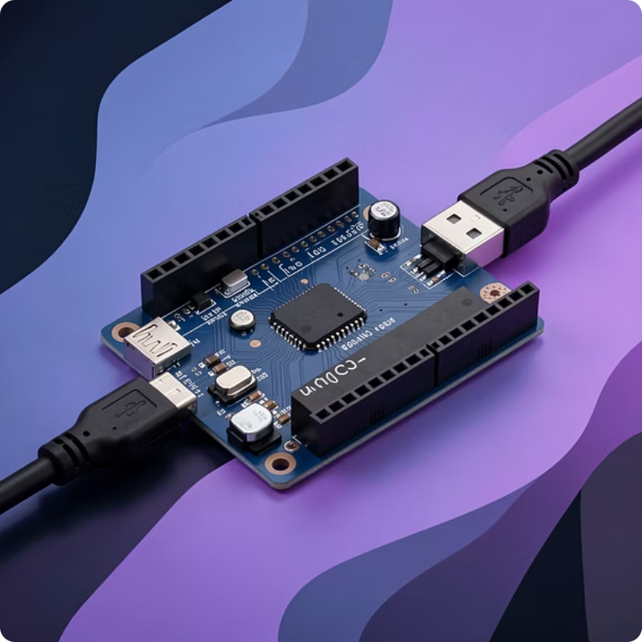
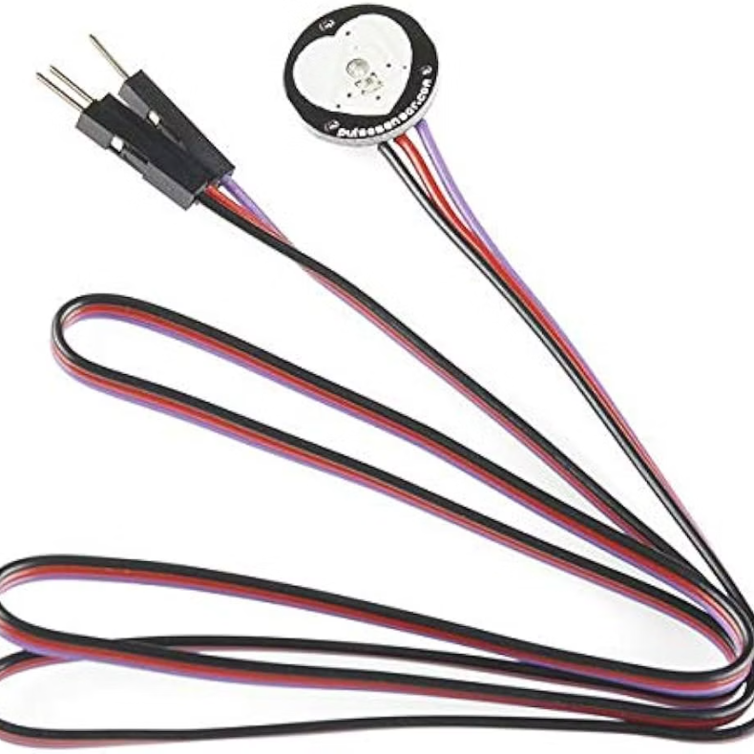
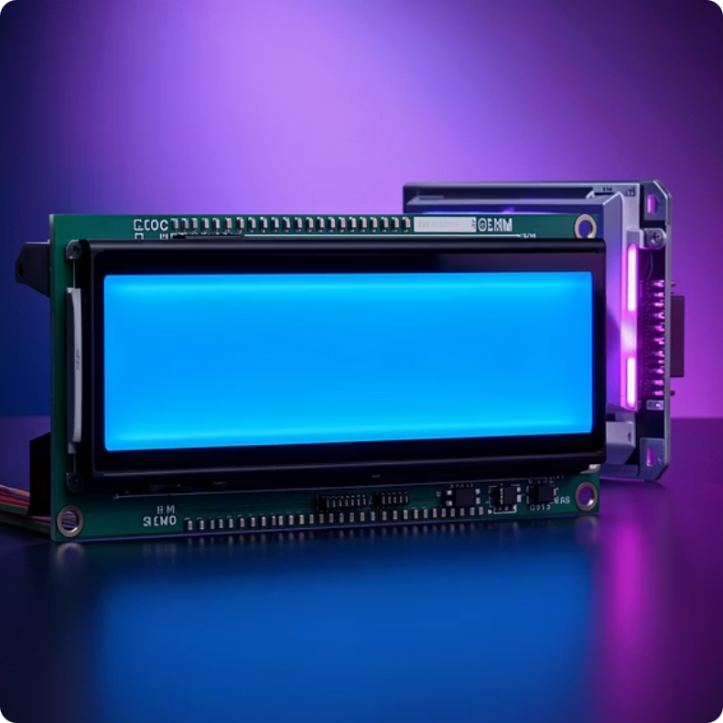
Essential Hardware Components
Arduino Uno/Nano
Pulse Sensor
LCD Display Module
The main processing unit that runs the monitoring algorithm and controls all system components. Cost-effective and widely available.
MAX30100 or MAX30102 optical sensor that detects blood volume changes through photoplethysmography (PPG) technology, typically clipped to a finger.
A 16x2 character LCD display used to show real-time heart rate readings (BPM) directly to the user.

Slide 6
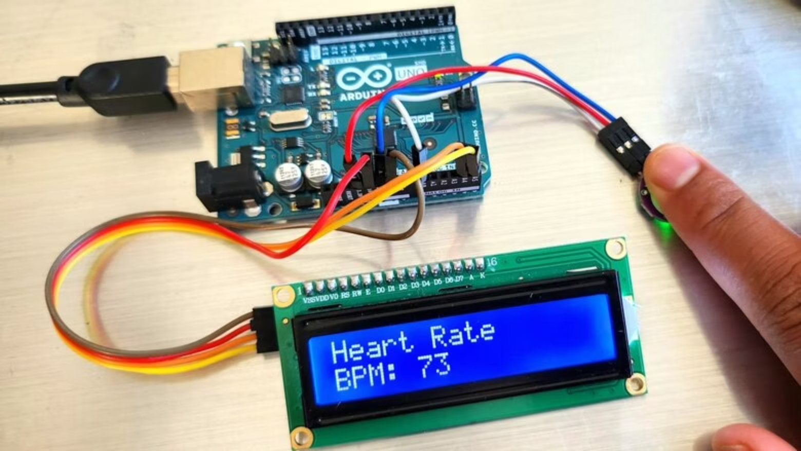




How the System Works
BPM Calculation
Pulse Signal Detection
Arduino processes the analog signal, filtering noise and identifying pulse peaks. The system calculates beats per minute by measuring the time interval between consecutive heartbeats.
The optical pulse sensor emits infrared light through the fingertip or earlobe, detecting changes in blood volume with each heartbeat. The sensor converts these optical changes into electrical signals.
Alert Triggering
Threshold Comparison
When BPM exceeds upper or lower thresholds, the system immediately activates the communication module and prepares emergency notification with current vital signs.
The calculated BPM is continuously compared against programmed safe values. Normal resting heart rate typically ranges from 60-100 BPM, with thresholds adjustable for individual patients.

Slide 7

Emergency Alert Mechanism
WhatsApp Notification System
The system leverages WhatsApp's reliable messaging infrastructure to deliver emergency alerts to caregivers, family members, or medical personnel instantly.
Alert Message Includes:
Patient identification information
Current BPM reading with timestamp
Warning level (mild, moderate, severe)
Recommended action steps
Follow-up instructions
Messages are sent to multiple contacts simultaneously, ensuring redundancy and rapid response even if one caregiver is unavailable.
30s
3+
Average Alert Time
Contacts Notified
From threshold breach to message delivery
Multiple caregivers receive simultaneous alerts
Important Note: The system requires internet connectivity through WiFi or cellular data. In areas without reliable internet, GSM-based SMS alerts serve as backup notification method.

Slide 8


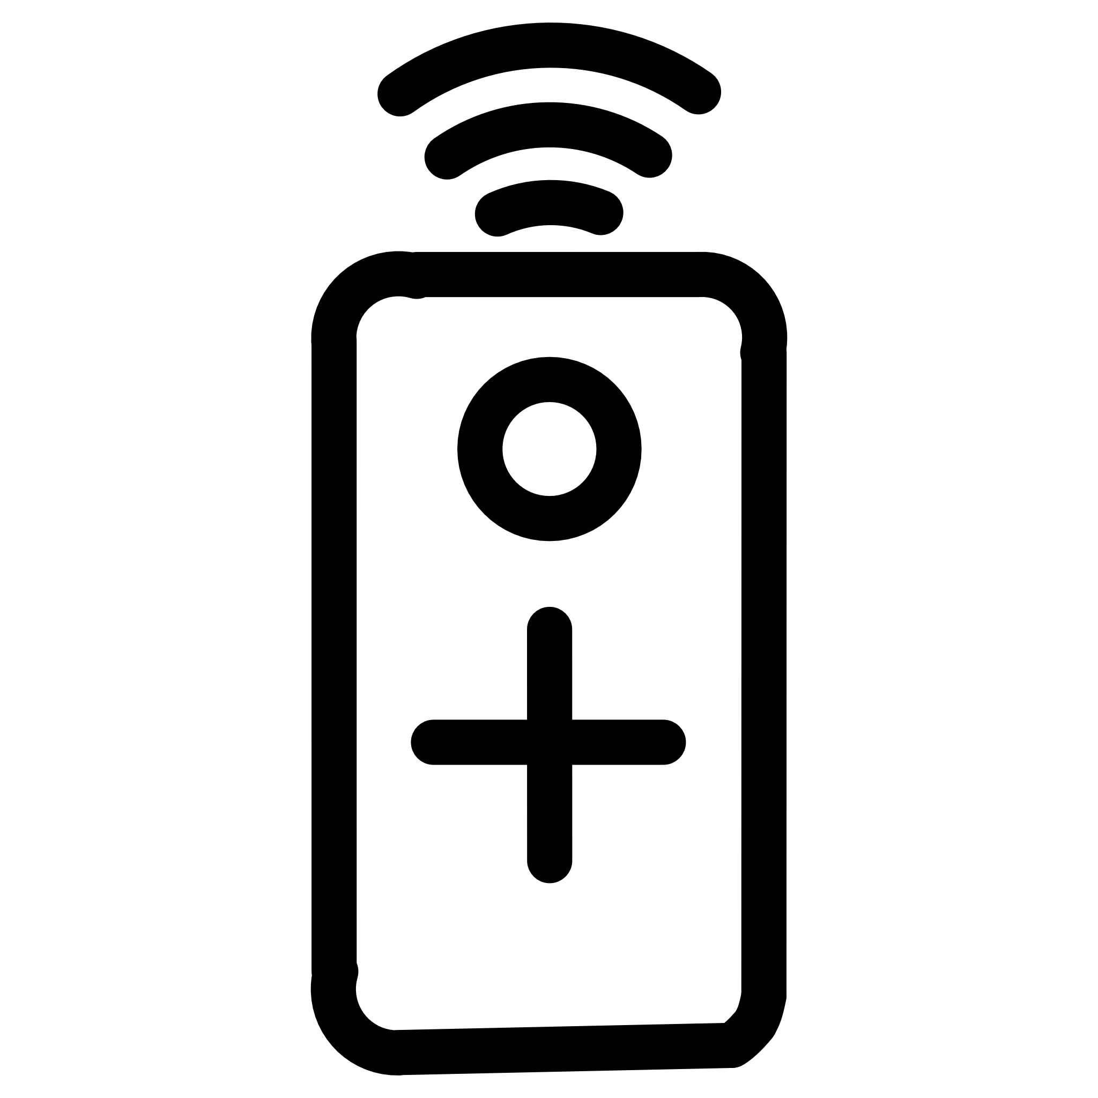

Real-World Applications
Home Elderly Care
Hospital Monitoring
Monitors senior citizens living independently, providing family members peace of mind while allowing seniors to maintain autonomy in their homes.
Supplements hospital telemetry systems for continuous observation of cardiac patients, reducing nursing workload while improving patient safety.
Remote Health Services
Post-Operative Care
Serves patients in rural or underserved areas where access to immediate medical care is limited, bridging healthcare gaps through technology.
Tracks recovery progress after cardiac surgery or procedures, alerting medical teams to complications during critical healing periods.
Cardiac Patient Management
Athletic Performance Tracking
Provides continuous monitoring for patients with arrhythmias, heart failure, or other cardiovascular conditions requiring close observation.
Coaches and trainers use similar systems to monitor athlete heart rates during training, preventing overexertion and optimizing performance.

Slide 9
System Advantages and Future Enhancements
Current Advantages
Cost-Effective Solution
Real-Time Monitoring
Total hardware cost under $40 makes it accessible to individuals and healthcare providers with limited budgets.
Continuous 24/7 surveillance with immediate alerts ensures no critical events go unnoticed during vulnerable periods.
Rapid Emergency Response
Portable and Scalable
WhatsApp alerts reach caregivers within seconds, significantly reducing response time compared to traditional monitoring methods.
Compact design allows monitoring anywhere, while modular architecture supports expansion to multiple patients simultaneously.
Future Enhancements
Mobile App Integration
Cloud Data Storage
Dedicated iOS/Android application for configuring thresholds, viewing historical data, and receiving push notifications.
Secure cloud-based logging of all readings for long-term trend analysis and sharing with healthcare providers.
GPS Location Tracking
AI-Based Prediction
Automatic location inclusion in emergency messages, helping first responders reach patients faster.
Machine learning algorithms to predict potential cardiac events based on historical patterns and anomaly detection.

Slide 10

Conclusion
"This Arduino-based heart monitoring system represents an accessible, reliable solution for continuous cardiac care that bridges the gap between hospital-grade monitoring and affordable home healthcare."
Proven Technology
Emergency Ready
Accessible Healthcare
Leverages mature Arduino ecosystem and reliable pulse sensing for accurate, dependable heart rate measurement.
Instant WhatsApp alerts ensure caregivers receive critical information when it matters most, potentially saving lives.
Low-cost implementation makes continuous cardiac monitoring available to populations who would otherwise lack access to such technology.
Next Steps
This project demonstrates feasibility and provides a working prototype. Future development should focus on regulatory compliance testing, clinical validation studies, and partnerships with healthcare providers for real-world deployment in patient care settings.

